Slide 1

JavaScript

Slide 3
SCRIPTING LANGUAGE
Operation System
Web Browser
Web Page
C++ Apps
Java Apps
.NET Apps
JavaScript
can’t access local files
can’t directly access database
can’t access hardware

Slide 4
JavaScript
is a
client-side language

Slide 5
JavaScript
is not
java

Slide 6
JavaScript
is
Interpreted
not
compiled

Slide 7
Javascript
is
Case
Sensitive!

Slide 8


alert(“Hello world”);
Alert(“Hello world”);

Slide 9
JAVASCRIPT STATEMENT
alert(“hello world”);
alert(“another message”);
This is realy realy realy realy
realy realy realy realy complex message;

Slide 10
JAVASCRIPT IS WHITESPACE INSENSITIVE
alert(“hello world”);
alert( “hello world” );
alert
( “hello world”
);
alert(“hello world”);

Slide 11
JAVASCRIPT COMMENT
//this is a comment
alert(“hello”); //this is a comment too
/*
this is
a multiple line
comment */

Slide 12
VARIABLES
var year;
var customerEmail;
var todaysdate;
var foo;
var x;
var 99problems;
var problems99;
letters
numbers
_
$

Slide 13
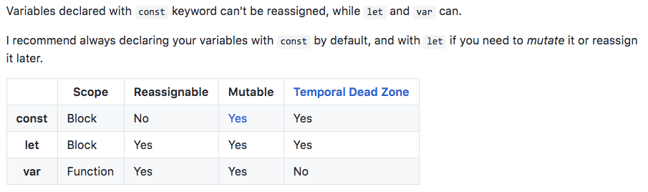
VARIABLES DECLARATION
var, let, const

Slide 14
VAR

Slide 15
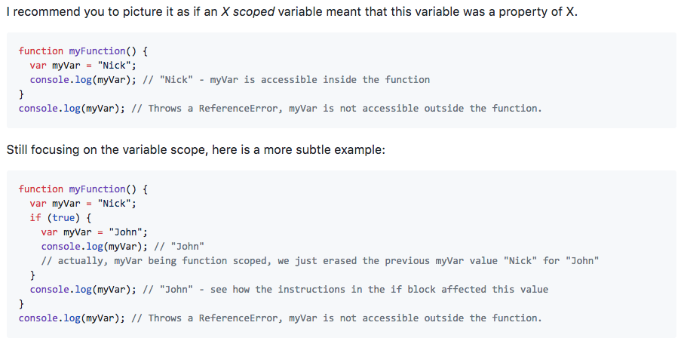
VAR

Slide 16
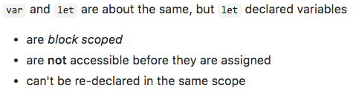
LET

Slide 17
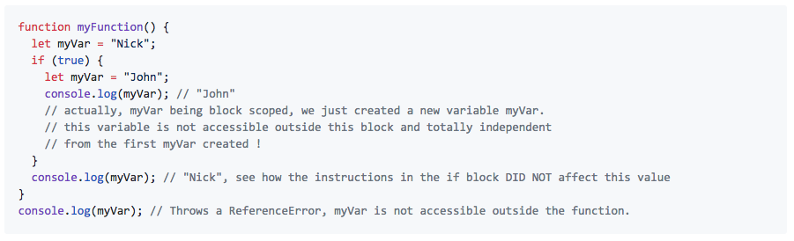
LET

Slide 18
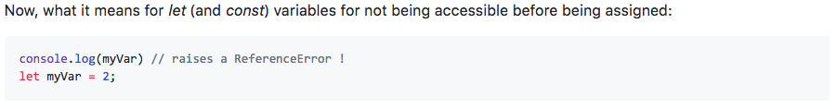
LET

Slide 19
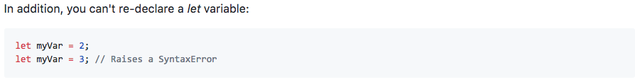
LET

Slide 20
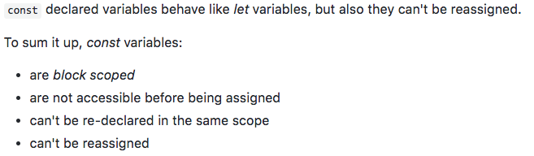
CONST

Slide 21
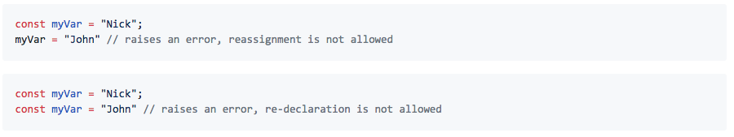
CONST

Slide 22
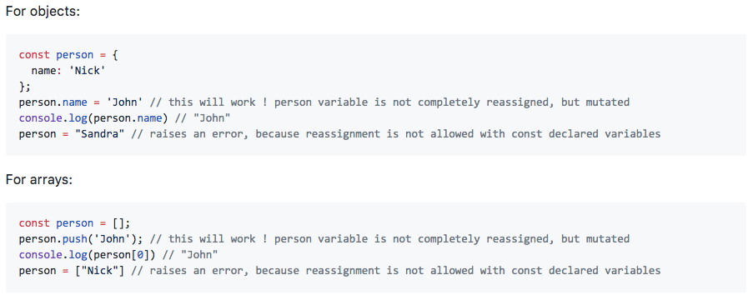
CONST

Slide 23
CONDITIONAL CODE
if ( condition ) {
// code goes here
// ...
} else {
// otherwise, different code
}

Slide 24
OPERATORS AND EXPRESSIONS

Slide 25
ARITHMETIC OPERATORS
* / + -

Slide 26
ASSIGNMENT OPERATORS
= += -= *= /=

Slide 27
EQUALITY
= assignment
== equality
=== strict equality

Slide 28
LOGICAL AND / OR
if ( a === b && c === d ) { ...
if ( a === b || c === d ) { ...
if ( (a > b) && (c < d) ) { ...

Slide 29
MODULUS
var year = 2003;
var remainders = year % 4;
// remainder is 3

Slide 30
INCREMENT/DECREMENT
a = a + 1 a = a – 1
a += 1 a -= 1
a++; //postfix a--;
++a; //prefix --a;

Slide 31
WORKING WITH LOOPS

Slide 32
WHILE LOOP
var a = 1;
while ( a < number ) {
document.write(a);
a++;
}

Slide 33
DO… WHILE LOOP
var a = 1;
do {
document.write(a);
a++;
} while ( a < number );

Slide 34
FOR LOOP
for ( var i = 1; i < 10; i++) {
// do stuff
// do stuff
// do stuff
// etc..
}

Slide 35
BREAK
for ( var i = 1; i < 100; i++) {
// do stuff
// do stuff
if ( i == 5) {
break;
}
// do stuff
}
// break jumps out the loop

Slide 36
CONTINUE
for ( var i = 1; i < 100; i++) {
// do stuff
// do stuff
if ( i == 5) {
continue;
}
// do stuff
}

Slide 37
FUNCTIONS
function myfunction (){
document.write (“test function”);
}
myFunction();

Slide 38
FUNCTIONS WITH PARAMETER
function myfunction ( x,y ){
var result = x*y;
document.write(result);
}
myFunction(200,300);

Slide 39
REFERENCES
https://www.w3schools.com/js/
https://javascript.info/
https://www.tutorialspoint.com/javascript/

Slide 40
The end.

